Slide 1
Introduction to SQL
Using SQLite

Slide 2
What is SQL
SQL stands for Structured Query Language
Let’s you access and manipulate databases
Became a standard of the American National Standards Institute(ANSI) in 1986
Became a standard of the International Organization for Standardization (ISO) in 1987

Slide 3
What can SQL do?
Used to query a database
CRUD
Create (Tables and Databases)
Retreive data from tables
Update records in tables
Delete records and tables and databases
Create stored procedures
Create views
Set permissions on tables, procedures and views

Slide 4
RDMS versus NoSQL
Relational Database Management Systems
Examples
SQLite - Free
MySQL – Free version owned by Oracle
SQL server – Free versions
Oracle DB2
Postgres – Free versions
IBM DB2

Slide 5
SQL Database Advantages
Table driven structured data (Columns and Rows)
Robust features and tools
Handles complex queries and reports
Handles high transaction applications
ACID compliance
Atomicity – Transactions acting only if all pieces successfully save
Consistency – Interrupted modifications are rolled back
Isolation – No other transactions take place and affect the transaction
Durability- System failures or restarts do not affect committed transactions

Slide 6
RDMS versus NoSQL
NoSQL is a database designed to allow for scalable data storage
Does not use tabular relationships
Designed for large amounts of unstructured data
NoSQL implementations
MongoDB
Casandra
Couchbase
Amazon DynamoDB
Hbase

Slide 7
NoSQL Database Advantages
Highly flexible for non tabular data
Scales well in a distributed system
Often open source and therefore lower cost
High availability and speed
Data Models
Document model – Uses JSON (JavaScript Object Notation)
Graph Model – All of the data resides on one machine
Key-Value Model – A key is required to retrieve and update data

Slide 8
What is Normalization?
Is a database design technique that reduces redundancy and eliminates undesirable characteristics like Insertion, Update and Deletion anomalies
Rules that divides larger tables into smaller tables and links them using relationships
The purpose is to eliminate redundant (repetitive) data and ensure data is stored logically
Edgar Codd the inventor of the relational model proposed this theory

Slide 9
Database Normal Forms
1NF (First Normal Form)
2NF (Second Normal Form)
3NF (Third Normal Form)
BCNF (Boyce-Codd Normal Form)
4NF (Fourth Normal Form)
5NF (Fifth Normal Form)
6NF (Sixth Normal Form)

Slide 10
1NF (First Normal Form) Rules
Each table cell should contain a single value
Each record needs to be unique

Slide 11
2NF (Second Normal Form) Rules
Be in 1NF
Single Column Primary Key (A unique identifier)
We will discuss key types later…

Slide 12
3NF (Third Normal Form) Rules
Be in 2NF
Has no transitive functional dependencies
What are transitive functional dependencies?
Is when changing a non-key column, might cause any other non-key column to change

Slide 13
BNF (Boyce-Codd Normal Form) Rules
Even when a database is in 3rd Normal Form, still there would be anomalies resulted if it has more than one Candidate Key
Candidate Key – Is a column or a set of columns that can qualify as a primary key in the database. There can be multiple candidate keys in a database relation and each candidate can work as a primary key for the table
Primary Key – Is a column or set of columns that identifies some record uniquely. Only one candidate key can qualify as the primary key.

Slide 14
4NF (Fourth Normal Form) Rules
If no database table instance contains two or more, independent and multivalued data describing the relevant entity, then it is in 4th Normal From

Slide 15
5NF (Fifth Normal Form) Rules
A table is in 5th Normal Form only if it is in 4NF and it cannot be decomposed into any number of smaller tables without loss of data

Slide 16
6NF (Sixth Normal Form) Proposed
Is not standardized

Slide 17
What is a KEY?
A key is used to identify a record in a table uniquely
A key could include one column or a combination of columns
Primary Key properties
Cannot be NULL
Must be unique
Should rarely changed
Must be given a value when a new record is inserted

Slide 18
Composite Key
Is a primary key composed of multiple columns used to identify a record uniquely

Slide 19
Foreign Key
Properties
References the primary key of another table
Can have a different name from its primary key
It ensures rows in one table have corresponding rows in another
They don’t have to be unique like the primary key
Can be null
Used in referential integrity

Slide 20
A Record
Is a data structure that can hold data items of different types
Is made up of one or more fields
An individual item in a table

Slide 21
A field
An intersection of a row and a column
A single entity of data
A single attribute of a row of data

Slide 22
Entity Relationship Diagram
Flowchart that illustrates the connection between tables
Shows the important fields in a table
Should always show the primary key
Should show foreign keys
Also used in object oriented diagrams to show relationship between classes, methods and objects
Resource: https://www.lucidchart.com/pages/er-diagrams

Slide 23
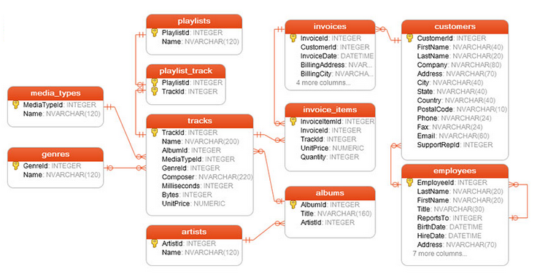
Entity Relationship Diagrams

